Slide 1
Young people’s voice in their education Why it matters!
T

Slide 2
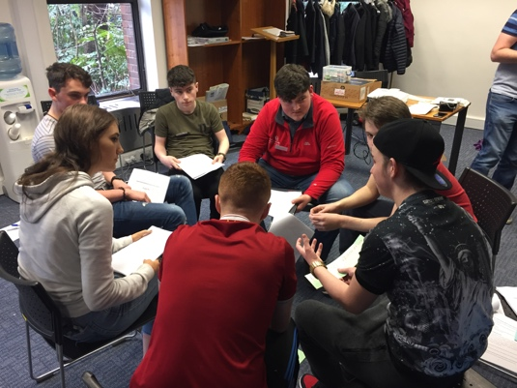
Aim of this workshop
To reflect on how we can support our young people in having their voices heard and taken seriously in matters that affect them in school.

Slide 3

United Nations Convention on the Rights of the Child

Slide 4
Article 12-The child’s opinion
The child has the right to give their opinion on matters that affect them and for adults to listen and take it seriously.
The child shall in particular be provided with suitable opportunities to be heard
Notes:
Article 12
The right to express views on all matters affecting them, and to have them given due weight, commonly described as participation, is embodied in the Convention on the Rights of the Child (CRC) in Article 12, and applies to all children capable of forming a view. However, its impact and implications take on additional and differing significance during adolescence (Lansdown 2018)

Slide 5
Graphic with the Associated Rights
Notes:
Participation needs to be understood not only through the lens of Article 12, but also within the framework of the wider civil rights embodied in the CRC – the rights to freedom of expression, of association, thought, conscience and religion, the right to privacy and to information. The opportunity for adolescents to exercise these rights can be seen as pre-conditions for the right to express views, have them taken seriously, and influence matters of concern to them.
Associated Articles 29
Education shall aim at developing the child’s personality, talents and mental and physical abilities to the fullest extent. Education shall prepare the child for an active adult life in a free society (Abridged)
Article 13 Right to expression

Slide 6
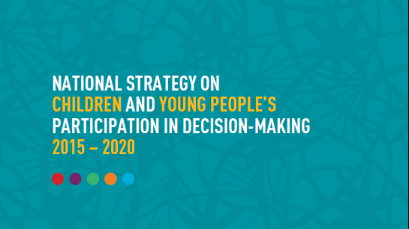
Notes:
Children and young people’s right to have their voices heard is part of the National Agenda.
Ireland signed the Convention in 1992 and in so doing the Government committed to realising these rights for young people.
Department of Children and Youth Affairs (DCYA) National Strategy on children and young people’s participation in decision making provides information and advice for government departments about how to support children and young people’s meaningful participation.

Slide 7

Draft National Implementation Framework for Child Participation

Slide 8
Picture
…support organisations in a self-improvement journey towards adopting best practice in giving children and young people a voice in decision-making.

Slide 9
Why should young people be involved in decision making about matters that affect them in school?
Young people are actors in their own development with their own rights, not passive recipients.
They have the right to influence decisions that affect them.
Involving young people helps deliver better decisions for them – more relevant and better informed responses, solutions and outcomes.
It makes us more accountable – by recognising and acting on young people’s contributions.
It means that our planning in schools is informed by the real views and perspectives of young people.
Young people benefit from participation – it contributes to their skills, power, confidence, enjoyment.
(Adapted from https://www.unicef.org/adolescence/files/Every_Childs_Right_to_be_Heard.pdf)

Slide 10
Find a partner……
On what area(s) of school life could our young people have an opportunity to have their voices heard in school now?
Whose voices would be heard?
Who should be listening?
What difference might it make?
Notes:
Participants are invited to reflect on these questions with a one or two colleagues.
When they return to their tables, there is an opportunity to share conversations and to identify some observations from the reflection.

Slide 11
Rationale
Picture of Young People

Slide 12
Young people are experts in their own experience of schooling
Young people have unique perspectives on learning, teaching and schooling; that their insights warrant not only the attention but also the responses of adults; and that they should be afforded opportunities to actively shape their education.
(Cook-Sather, 2006)

Slide 13
Benefits of building participation ……
Improves relationships in school
Changes the experience of ‘power’ in school…. Sharing power and responsibility for learning
Builds/improves self confidence and self esteem
Encourages leadership potential and involvement in school activities (inside and outside the classroom!)
Impacts positively on learning and the general experience of/engagement with school
(Flynn 2013 & 2014)

Slide 14

Development of active, democratic citizens
Schools are the first place where children experience society in all its facets and their experiences can have a profound influence on their attitudes and behaviour in life.
Andreas Schleicher, (OECD, 2017)
Notes:
Schools should contribute to the development of active, democratic citizens.
Active participation and having a voice Are ways for students to experience and develop democratic attitudes and skills in education.
Citizenship as practice as opposed to citizenship as status.
Lawy and Biesta 2016
Young people’s participation in decision making leads to Capacity development: Meaningful participation enables adolescents to acquire knowledge and skills, build competencies, extend aspirations, and gain confidence. Participation promotes adolescents’ capacities for civic engagement, collective organisation, tolerance and respect for others. Societies require citizens with the understanding, skills, and commitment to promote accountability and good governance. Participation enables adolescents to develop those capacities (Lansdown 2018)

Slide 15

When pupils are consulted seriously, it can make them feel, often for the first time, that the school and the class are, to some extent, their school and their class…impacting on their sense of belonging and attachment.

Slide 16
Why Voice matters DCYA Video
At your table,
What are the key messages for us in the rationale ?
What would be the benefits for our students?

Slide 17
In our school, where are decisions made that affect young people? (Wordle)
School Self Evaluation (SSE)
Policy Development
Special Interest Groups
Student Led Projects
Reporting
Classroom culture
Learning and assessment
Student Council
Follow up to WSE

Slide 18
In our school, where are decisions made that affect young people? (Wordle)
Notes:
Consider

Slide 19
Conceptual Framework for Measuring Outcomes of Adolescent Participation
https://www.unicef.org/adolescence/files/Conceptual_Framework_for_Measuring_Outcomes_of_Adolescent_Participation_March_2018.pdf
No participation or unethical participation
In most societies, the majority of young people have little or no opportunity to express their views
Consultative participation
adult initiated;
adult led and managed
lacking possibility for young people to control outcomes;
recognizing the added value that young people’s perspective, knowledge and experience can contribute.
Collaborative
Participation
adult initiated;
involving partnership with young people
enabling young people to influence or challenge both process and outcome;
allowing for increasing levels of self-directed action by young people over a period of time.
Young Person-led
Participation
the issues of concern being identified by young people themselves
adults serving as facilitators rather than leaders
Young people controlling the process and the outcomes.
Notes:
Young people can participate in activities, processes and decision-making in broadly three different ways: consultative, collaborative, or young person-led. (Lansdown G & O’Kane C (2014) A Toolkit for Monitoring and Evaluating Children’s Participation, Save the Children et al, London
)
Conceptual Framework for Measuring Outcomes of Adolescent Participation
https://www.unicef.org/adolescence/files/Conceptual_Framework_for_Measuring_Outcomes_of_Adolescent_Participation_March_2018.pdf
It is important not to perceive them in terms of a hierarchy of preference.
Each mode of participation offers differing degrees of empowerment and influence, but they are all legitimate and appropriate in different contexts, and can be rights-respecting provided they comply with the features of space, voice, audience and influence, and the nine basic requirements for quality (from CRC General Comment No. 12, The right of the child to be heard, CRC/C/GC/12, 2009 )
.

Slide 20
Participation must always be… CRC General Comment No. 12, The right of the child to be heard
Transparent and informative
Voluntary
Respectful
Relevant
Young person-friendly
Inclusive
Supported by training for adults
Accountable
Notes:
Without compliance, participation runs the risk of being tokenistic, manipulative or even coercive.
CRC General Comment No. 12, The right of the child to be heard, CRC/C/GC/12, 2009
Transparent and informative - young people must be provided with full, accessible, diversity-sensitive and age-appropriate information about their right to express their views freely and their views to be given due weight, and how this participation will take place, its scope, purpose and potential impact
Voluntary - young people should never be coerced into expressing views against their wishes and they should be informed that they can cease involvement at any stage
Respectful - young people’s views have to be treated with respect and they should be provided with opportunities to initiate ideas and activities. Adults working with young people should acknowledge, respect and build on good examples of young people’s participation, for instance, in their contributions to the family, school, culture and the work environment. They also need an understanding of the socio-economic, environmental and cultural context of young people’s lives. Persons and organizations working for and with young people should also respect young people’s views with regard to participation in public events;
Relevant - the issues on which young people have the right to express their views must be of real relevance to their lives and enable them to draw on their knowledge, skills and abilities. In addition, space needs to be created to enable young people to highlight and address the issues they themselves identify as relevant and important;
Young person-friendly - environments and working methods should be adapted to young people’s capacities. Adequate time and resources should be made available to ensure that young people are adequately prepared and have the confidence and opportunity to contribute their views. Consideration needs to be given to the fact that young people will need differing levels of support and forms of involvement according to their age and evolving capacities;
Inclusive - participation must be inclusive, avoid existing patterns of discrimination, and encourage opportunities for marginalized young people, including both girls and boys, to be involved. Young people are not a homogenous group and participation needs to provide for equality of opportunity for all, without discrimination on any grounds. Programmes also need to ensure that they are culturally sensitive to young people from all communities;
Supported by training - adults need preparation, skills and support to facilitate young people’s participation effectively, to provide them, for example, with skills in listening, working jointly with young people and engaging young people effectively in accordance with their evolving capacities. Young people themselves can be involved as trainers and facilitators on how to promote effective participation; they require capacity-building to strengthen their skills in, for example, effective participation awareness of their rights, and training in organizing meetings, raising funds, dealing with the media, public speaking and advocacy
Safe and sensitive to risk - in certain situations, expression of views may involve risks. Adults have a responsibility towards the young people with whom they work and must take every precaution to minimize the risk to young people of violence, exploitation or any other negative consequence of their participation. Action necessary to provide appropriate protection will include the development of a clear child-protection strategy which recognizes the particular risks faced by some groups of young people, and the extra barriers they face in obtaining help. Young people must be aware of their right to be protected from harm and know where to go for help if needed. Investment in working with families and communities is important in order to build understanding of the value and implications of participation, and to minimize the risks to which young people may otherwise be exposed;
Accountable - a commitment to follow-up and evaluation is essential. For example, in any research or consultative process, young people must be informed as to how their views have been interpreted and used and, where necessary, provided with the opportunity to challenge and influence the analysis of the findings. Young people are also entitled to be provided with clear feedback on how their participation has influenced any outcomes. Wherever appropriate, young people should be given the opportunity to participate in follow-up processes or activities. Monitoring and evaluation of young people’s participation needs to be undertaken, where possible, with young people themselves.

Slide 21
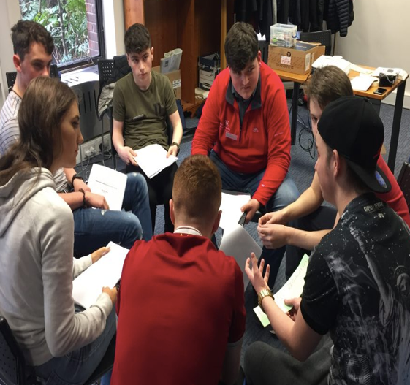
Whose voices can we hear in these different contexts?
Collective
Whole school
Year group
Representative
Informal conversations
Individual
Special interest groups, e.g. Active School Flag
Class group
Class/year representatives
Student Council
Opportunities for individuals to have their voice heard.

Slide 22
What are the features of meaningful participation?
The right to express views
Article 12
The right to have views given due weight
Space
Safe and inclusive opportunity to form and express views
Voice
Facilitated to form and express views freely in a medium of choice
Influence
The views must be acted upon
Audience
The view must be listened to
Notes:
Lundy describes four elements for meaningful participation
At the level of any specific participatory activity, attention must be afforded to the specific obligations placed on the adult duty bearers under Article 12 in order for it to be meaningful and effective.
Space: In order to become increasingly active in influencing matters affecting them, adolescents need to be able to form and express views and they must be afforded the space and time to do so. Adolescents must be given the opportunity to gain the confidence, the time and space to contribute their views.
• Voice: Adolescents can express themselves through multiple different media, e.g. digital media, art work, written, spoken. Appropriate and accessible information is an important pre-requisite for the ability to speak out and express views and negotiate decisions. This needs to be provided in different forms according to the adolescents concerned, for example in relevant languages, in sign language, braille or other forms of augmented communication. Not all adolescents will be able to express themselves easily. The onus is on supporting adults to find ways in which to enable adolescents to communicate their views, concerns or ideas.. It is worth remembering that, according to Article 12, participation rights are based on the capacity to form a view, and not on the ability to express a view in any particular way.
• Audience: Central to the right to participate is that adults listen respectfully to what young people have to say. They must have access to the relevant audience for the views being expressed – teachers, senior management, parents, Board of Management. The right to express views and have them given due weight can only be realised if young people’s views are heard by those people with the power and authority to act on those views.
• Influence: The right to participate does not imply that young people’s’ views must always be acted on. However, it does require that their views are given proper consideration and that any decision that is subsequently made is reported back to them with an explanation of how and why it was made in the way that it was.

Slide 23
DCYA Toolkit
Places to Start – show the different folders ….you decide
Show one of the videos …This is where one school started
How to engage…consult, collaborate, Young person led…not linear
Invite staff to indicate interest ….little fires. GROW
Graphics Grow Model, Planning Template and Participation Prompts

Slide 24
What are the features of meaningful participation?
The right to express views
Article 12
The right to have views given due weight
Space
Safe and inclusive opportunity to form and express views
Voice
Facilitated to form and express views freely in a medium of choice
Influence
The views must be acted upon
Audience
The view must be listened to
Notes:
Lundy describes four elements of participation
The child has the right to give their opinion on matters that affect them and for adults to listen and take it seriously.
The child shall in particular be provided with suitable opportunities to be heard
At the level pf any specific, participatory activity , for it to be meaningful and effective, all four of these quadrants need to be considered.

Slide 25
Listening Culture in schools
“Voice is the tool by which we make ourselves known, name our experience, and participate in decisions that affect our lives” (Shannon 1993)
Changing the power dynamics between adults and young people within and beyond classrooms creates the possibility for students to embrace “the political potential of speaking out on their own behalf” (Lewis, 1993)
When students speak out on their own behalf, and when what they say matters—indeed, shapes action—student voice becomes “the initiating force in an enquiry process which invites teachers’ involvement as facilitating and enabling partners in learning” (Fielding, 2004b, p. 201)

Slide 26
Next Steps
In your teams…GROW Model with opportunity to sketch template
Participation prompts to guide template

